Slide 1
WHY WE BELIEVE… …we are created to know God

Slide 3
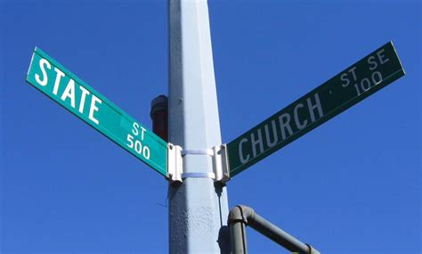

Slide 4
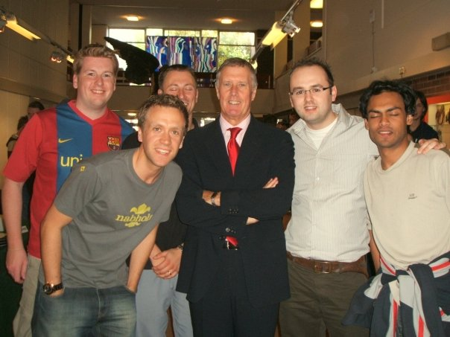

Slide 5
We are made in the image of God
So God created mankind in his own image, in the image of God he created them; male and female he created them.
Gen 1:27

Slide 6
Imago Dei:
The Image of God
We LOOK like God
We ACT like God
We SPEAK like God
We LIVE like God
We LOVE like God
We CREATE like God

Slide 7
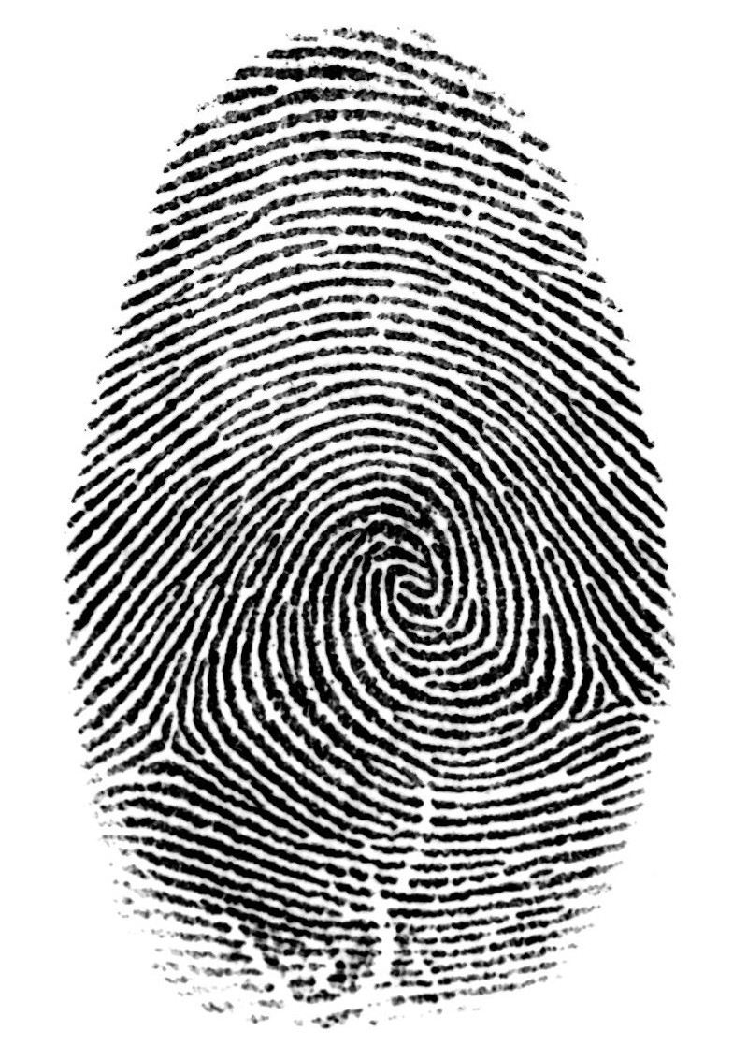
Our identity is IN Christ

Slide 8
We are made to glorify God

Slide 10
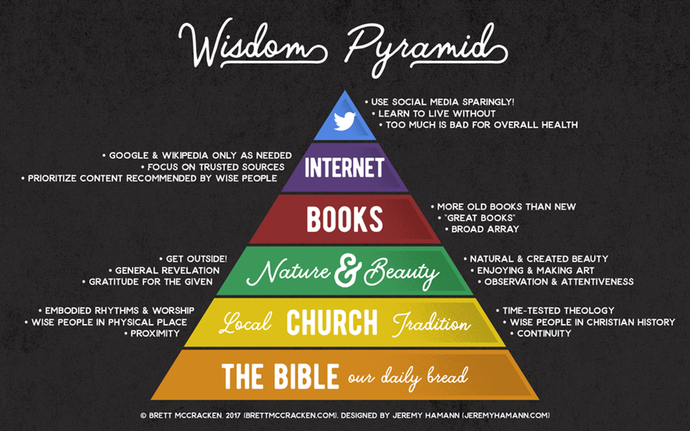

Slide 12
We are made in the image of God
Our identity is in Christ
We are made to glorify God

